Slide 1

Mortgage Modification Mediation
HAMP, HARP and other government programs are sunseting
State Court Mediation Programs ☹
Joint programs with law schools ☹
Isn’t this an idea whose time has passed?

Slide 2
What do we know about Mortgage Modification?
HAMP, HARP and other government programs may be about to sunset
State Court Mediation Programs ☹
Joint programs with law schools ☹
The real estate crisis is nearly over
Isn’t this an idea whose time has passed?
Florida and other jurisdictions tell us otherwise

Slide 3
In 2010 Judge Jennemann in Florida thought there must be a better way
TASK FORCE
They rolled up their sleeves and created a
MORTGAGE MODIFICATION MEDIATION Program

Slide 4
What was needed to make it work?
Do it in the context of a chapter 13 bankruptcy
  Resolves unsecured debt
  Allows strip off of junior liens
  Provided for accountability/transparency of payments through the Chapter 13 Trustee
Use Mediators trained in …
  Mediation
  Bankruptcy
  Mortgage Modification
Pay everybody in the context of the bankruptcy
  $2,500 for debtor’s counsel (in addition to fees for the bankruptcy)
  $600 for the mediator
Use a Portal for transmission of documents and communication

Slide 5

An overview of how the portal helps:

Slide 6
Florida results?
Over 6000 MMM Motions in the Orlando division alone
64.7% approval rate (compared to < 4% in state court)
Encourages bankruptcy filings
Decreases Ch 13 Trustee % fee for everyone
Loans go to permanent status faster and with better tracking
Loan modifications have become a new way of doing business post-real estate crisis

Slide 7
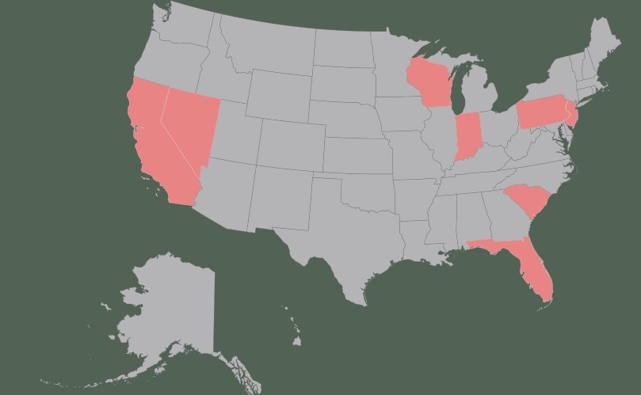
The idea is spreading…

Slide 8
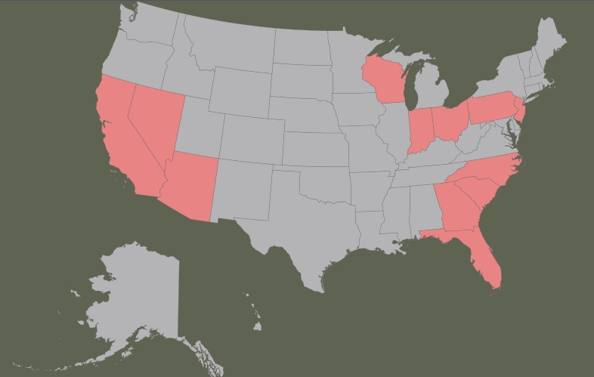
Coming soon …

Slide 9
What is happening in Arizona?
In March the judges and Chapter 13 trustees sat through presentation from Orlando parties
All seven judges liked the idea and instructed further action for a pilot
Task Force formed to develop program
  Trustees
  Debtors’ Counsel
  Creditors’ Counsel
  Potential mediators
Proposed Procedures, Forms and General Order have been presented to the Judges
Target effective date is January 1, 2017
Full Day Training Program December 9, 2016, Wild Horse Pass Resort
  Train lawyers and paralegals
  Train mediators

Slide 10
How will MMM work in AZ?
File Chapter 13 and pay all filing fees
Propose a plan with Estimated Monthly Payments (31% of gross monthly income)*
Debtor requests referral to MMM within 90 days of filing
  Debtor uses the Portal and DocuMod to prepare documents and communicate
  Debtor pays for Portal, DocuMod, and half the mediator fee
Creditor responds and pays its half of mediator fee

Slide 11
Mediator schedules mediation **
  Up to 2 one hour sessions
  Can pay for additional time if parties agree
If trial modification reached, request court approval of trial modification
Amend plan so Trustee disburses trial payments
If trial is successful, file a request to approve the final modification
If modification is unsuccessful, amend plan
  Surrender
  Cure and pay conduit plan

Slide 12
Estimated Monthly Payments
31% of gross income or monthly mortgage payment (aka an affordable payment)
Develop a history of making payments
  Shows good faith
  Demonstrates feasibility
Forces debtors to be realistic
Provides Debtor with options
  Fund balance of plan
  Fund a down payment in modification

Slide 13
What this means for you …
An additional tool available to bankruptcy attorneys
Training available for attorneys and their staff
  Debtors
  Creditors
  Potential Mediators
December 9, 2016, Wild Horse Pass Resort & Casino

